Slide 1


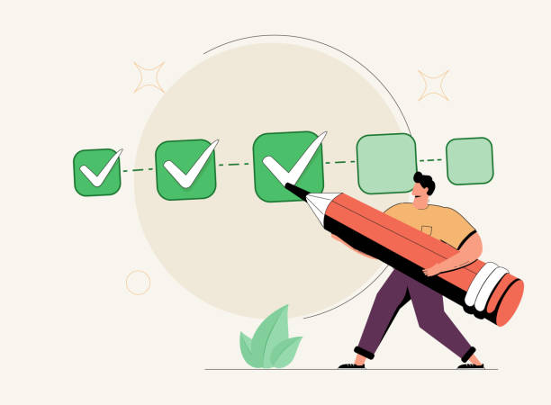

Predictors of Work Life Balance For Men
Key Insights for a better life through Statistical & Machine Learning methods
By Hassan Ali, Jack Baxter

Slide 2
Predict Men’s Work-Life Balance (WLB) Score: a Machine learning Approach
Develop an ML model to predict men’s work-life balance score based on lifestyle factors
Why
To identify factors that contribute to a healthy work-life balance and support growing research in men’s mental health
Motive
Amid the challenges of balancing work and the MS AAI program, this project offers valuable insights that can guide meaningful adjustments to improve work-life balance
Objective

Slide 3
Dataset Overview
Snapshot of variables used in predicting WLB Score
Source: Kaggle.com
Name: Lifestyle_and_Wellbeing Data
Summary:
15,972 respondents
6,114 men (selected cohort)
9,858 women
24 Variables
19 numeric – our selection set
Variable Name | Variable Description
DAILY_STEPS | Number of steps (in thousands) walked everyday (0-10 Scale)
PLACES_VISITED | Number of new places visited (0-10 Scale)
CORE_CIRCLE | Number of people close to you (0-10 Scale)
SUPPORTING_OTHERS | Number of people you supported to achieve better life (0-10 Scale)
What does your WLB score reveal?
The higher your WLB score, the more balanced and fulfilled your life is—thanks to various factors identified through our predictive analysis
ACHIEVEMENT | Number of remarkable achievements you are proud of (0-10 Scale)

Slide 4
Data Analysis & Preparation
Data Cleaning Activities
• Checked for missing values (none found in the dataset).
• Removed irrelevant columns such as Timestamp to focus on meaningful data.
Detecting Outliers
• Boxplots and histograms were used to detect outliers in key variables
• Countplots visualized distributions for discrete variables.
Data Types
Ensured all training and test data had appropriate data types for our selected Model (dropped non-numeric columns).

Slide 5
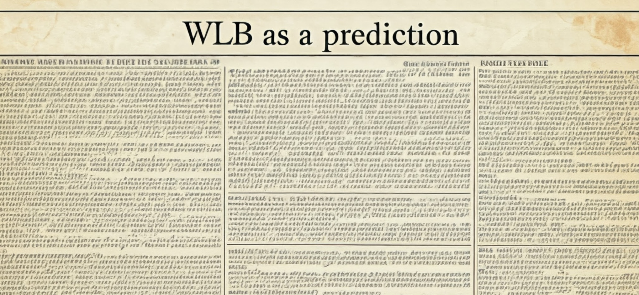
Sampling Method
Random sampling with replacement
Split the dataset into training and test
Ensured replicability with a fixed random state (42)
Work-Life Balance (WLB) scores were separated for prediction
Model Selection
A Random Forest Regressor was used with 100 trees
Results:
Mean Squared Error (MSE): 158.31 – measure of average squared difference between actual and predicted WLB score
R-squared (R²): 0.93 – 93% of the variance in Work-Life Balance (WLB score) is explained by the model

Slide 6
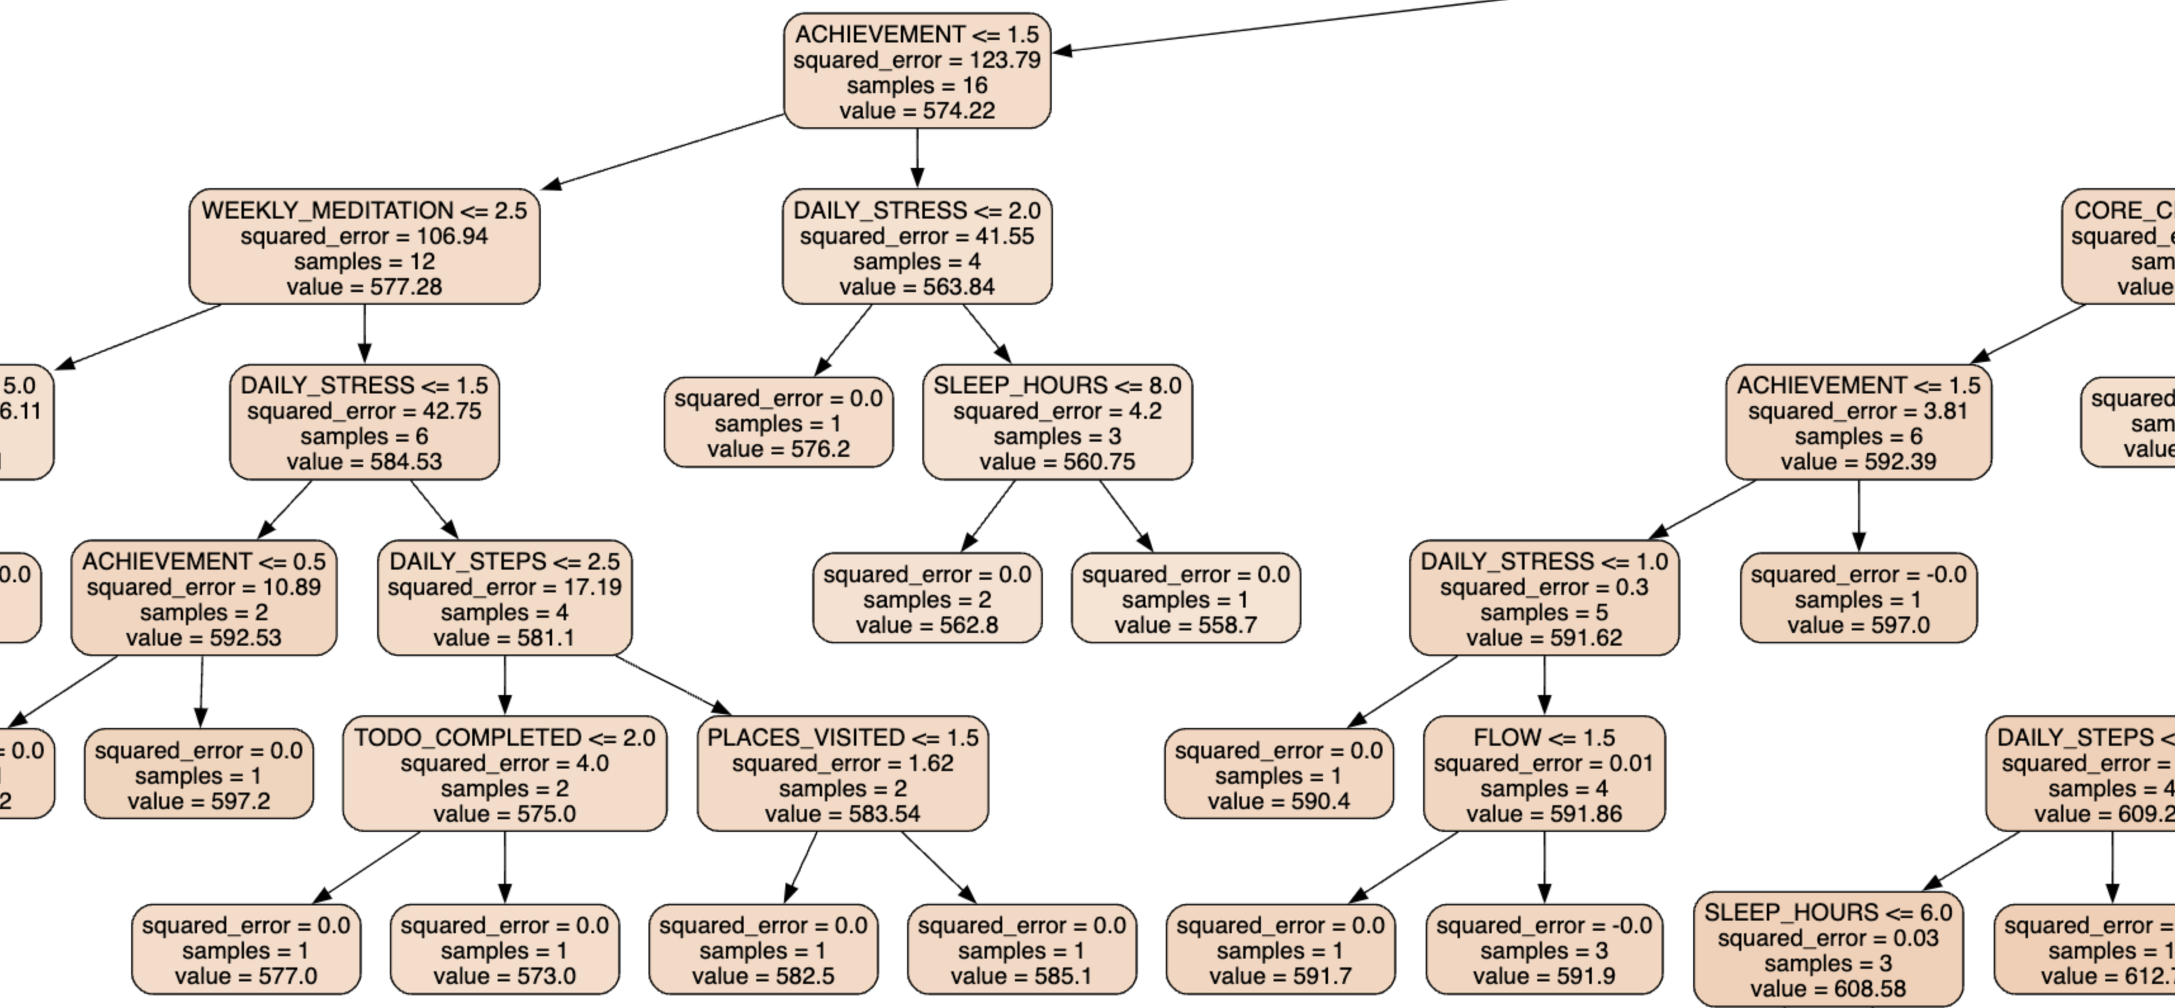
WLB Score – TOP Predictors
Feature
Importance
Achievement: How many remarkable achievements are you proud of?
0.263
Men with higher WLB scores generally tend to lead a lifestyle that emphasizes achieving personal goals, supporting others and exploring new places, among other factors.
Task Completed: How will do you complete your weekly to-do lists?
0.101
Supporting Others: How many people do you help achieve a better life?
0.099
Placed Visited: How many new places do you visit?
0.078
Sufficient Income: How sufficient is your income to cover basis expenses?
0.057
Snippet of a single/100 decision tree estimator within Random Forest Model

Slide 7
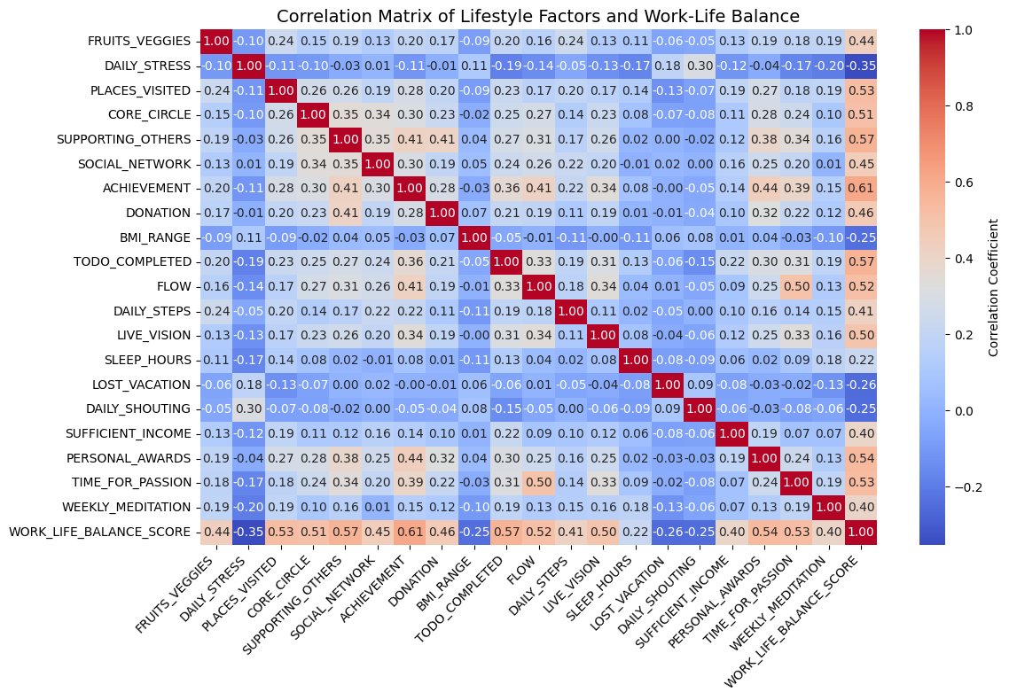
Comparing Random Forest’s Results with Correlation Matrix...
Correlation Matrix
In correlation matrix, Supporting Others (0.53) and Task Completion (0.54) show the strongest positive correlations with WLB, followed by Achievement (0.44).
These relationships suggest that social support and productivity are crucial to maintaining balance.
Compared with Random Forest
The Random Forest model, Achievement as the most important predictor (26.3% variance explained), despite its lower linear correlation in the matrix. Task Completion and Supporting Others were also identified as important in both analyses, though their influence appears stronger in the linear correlation.

Slide 8
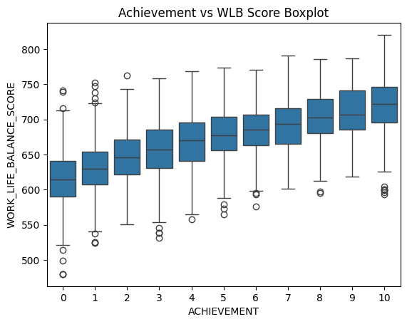
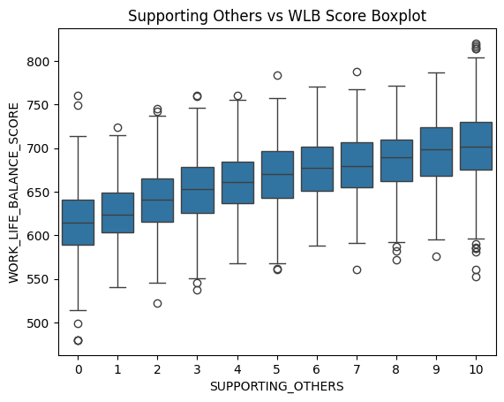
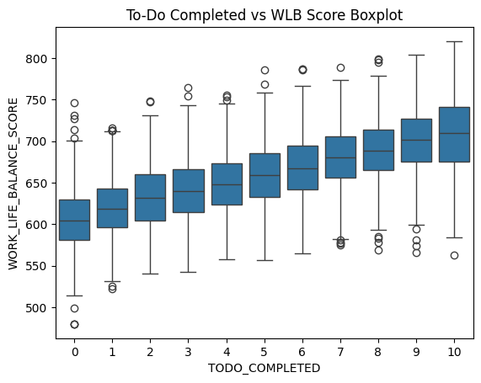
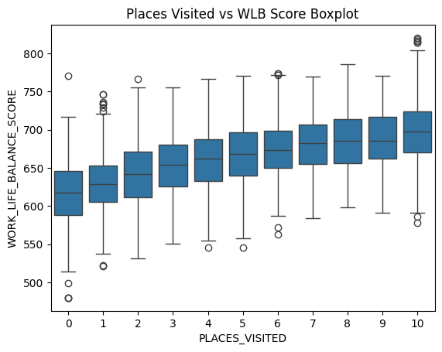
BoxPlot Insights
Achievement: Higher achievement levels correlate with better WLB scores, confirming that professional success is linked to well-being
Supporting Others: More support for others shows a positive correlation with WLB, possibly reflecting social well-being
To-Do Completed: Completing tasks correlates with better WLB scores, indicating the importance of productivity for balance
Places Visited: People who traveled more often had higher WLB scores, indicating that recreation and exposure to new environments enhance well-being.

Slide 9
Conclusion
Life Beyond Work: Personal Goals, social connections and exploration enhance WLB – what we do outside the office matters
ML-Driven Insights: Captured complex patterns, ensuring robust reliable insights into top predictors of WLB score
Next Gen Models: Future-proof the analysis – explore new variables, enhance selection, and experiment with alternative algorithms
Big Picture Impact: Our insights set the stage for actionable strategies to boost men’s well-being and drive future AI-driven health research

Slide 10

Collaboration in Action
Team Member | Contribution
Hassan Ali | Identified dataset and performed initial EDA Prepared Presentation Prepared Technical report
Jack Baxter | Model Selection Code Execution, Read Me file Drafted Presentation outline

